Slide 1
STOCK MANAGEMENT SYSTEM
GOVERNMENT COLLEGE OF ENGINEERING, TIRUNELVELI
NAME: KEERTHIKA S
REGISTER NAME: 950820104022
ROLL NO: 20CS822

Slide 2
PROBLEM STATEMENT
The stock maintenance system which take care of sales information of the company and analyze the potential of the trade. It maintains the data in efficient manner. The existing system was recorded manually on pen and paper and time consuming one. To overcome this we are operating it in system and database for delivering accurate and real time information on stocks. This is also helps in calculating the total stocks, pending stocks and updating. It is mainly used in business sector to maintain stock level and profit and unprofitable product. This is mainly used by sales person and customers. This system is used for time and money saving, increases productivity and efficiency and also used for accurate data analysis of stocks. Also used for analysis the data in real-time requirements of the stocks.

Slide 3
introduction
Stock maintenance is an interface between the customer and the sales person. It aims at improving the efficiency in maintaining the stocks.

Slide 4
purpose
The entire process of stock maintenance is done in a manual manner considering the fact that the number of customer for purchase is increasing every year, a maintenance system is essential to met the demand. So this system uses several programming and database techniques to elucidate the work involved in this process.

Slide 5
scope
The system provides an interface to the customer where they can fill in orders for the items needed.
The sales person is concerned with the issues of items and can use this system.
Provide a communication platform between the customer and the sales person.

Slide 6
overview
SRS INCLUDES TWO SECTION OVERALL DESCRIPTION AND SPECIFIC REQUIREMENTS.
OVERALL DESCRIPTION:
IT WILL DESCRIBE MAJOR ROLE OF THE SYSTEM COMPONENTS AND INTER CONNECTIONS.
SPECIFIC REQUIREMENTS:
IT WILL DESCRIBE ROLES AND FUNCTION OF THE ACTORS.

Slide 7
OVERALL DESCRIPTION
PRODUCT PERSPECTIVE:
The stock maintenance acts as an interface between the ‘customer’ and the ‘sales person’. This system tries to make the interface as simple as possible and at the same time not risking the work of data stored in.
SYSTEM FUNCTIONS:
secure order of information by the customer.
schedule the customer an appointment for normal delivery of the product.

Slide 8
User characteristics
CUSTOMER: The person who orders for the items
VALIDATE CUSTOMER: the items ordered by the customer are validated.
SALES DETAILS: maintains the stock details after delivering the items to the customer.

Slide 9
assumptionS
Based on the sales orders given to the supply chain management they check the availability of the raw materials and then they supply and manufacture products.
The inventory system has the list of the products and quantity of the products. Depending upon the sales of the product the exact details about the product is displayed to the user.
From this the customers selects the product to sell.

Slide 10
Architecture Specifications
Hardware Requirements
PROCESSOR : 64-bit
ROM : 2GB
RAM : 4GB
2. Software Requirements
OPERATING SYSTEM : WINDOWS 8/10
FRONT END : JAVA NETBEANS
BACK END : MYSQL

Slide 11
FUNCTIONAL REQUIREMENTS
CUSTOMER REGISTRATION
PRODUCT MANAGEMENT

Slide 12
NON-FUNCTIONAL REQUIREMENTS
1. PERFORMANCE
A. STATIC REUIREMENTS
1. NUMBER OF TERMINALS
2. NUMBER OF USERS
B. DYANAMIC REQUIREMENTS
2. RELIABILITY
3. AVAILABILITY
4. SECURITY
5. MAINTAINABILITY
6.PORTABILITY

Slide 13
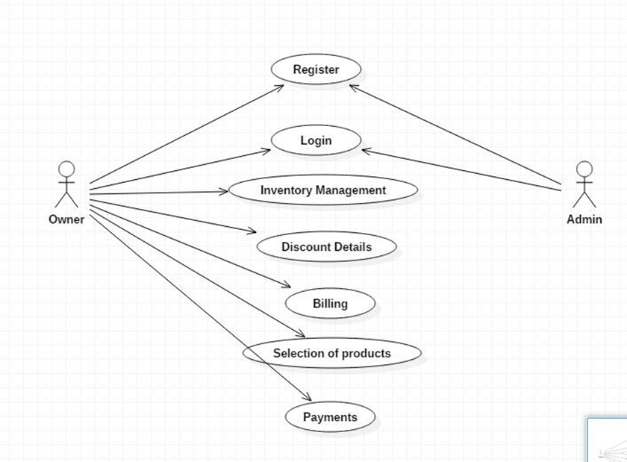
USECASE DIAGRAM

Slide 14
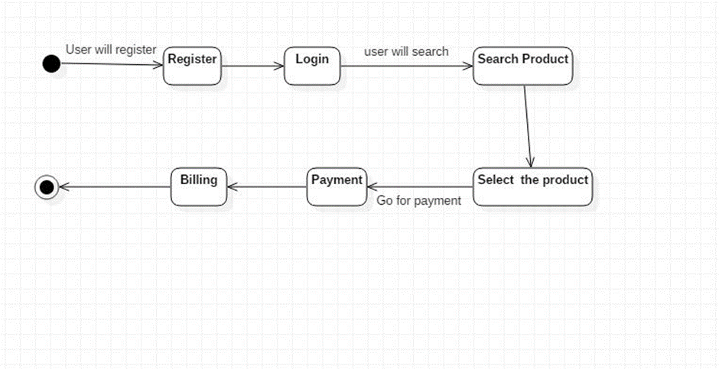
STATE CHART DIAGRAM

Slide 15
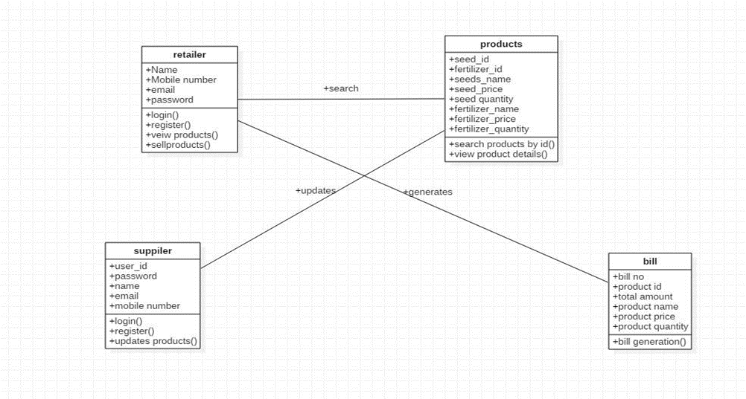
CLASS DIAGRAM

Slide 16
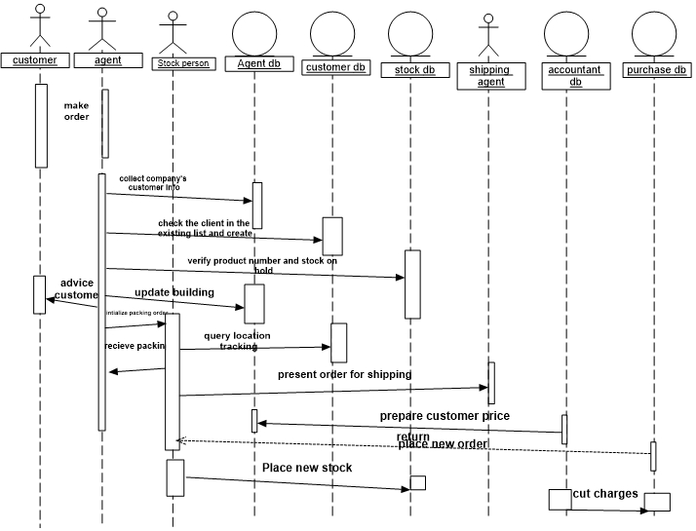
SEQUENCE DIAGRAM

Slide 17
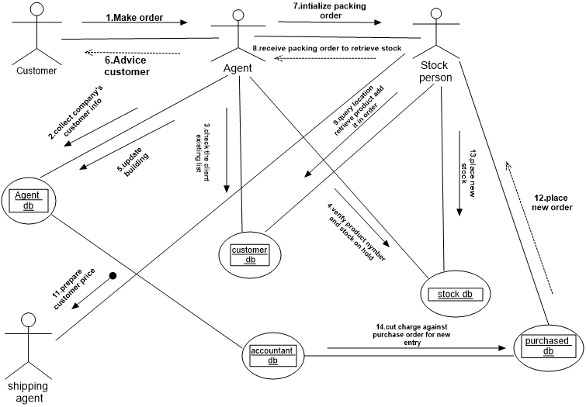
COLLABORATION DIAGRAM

Slide 18
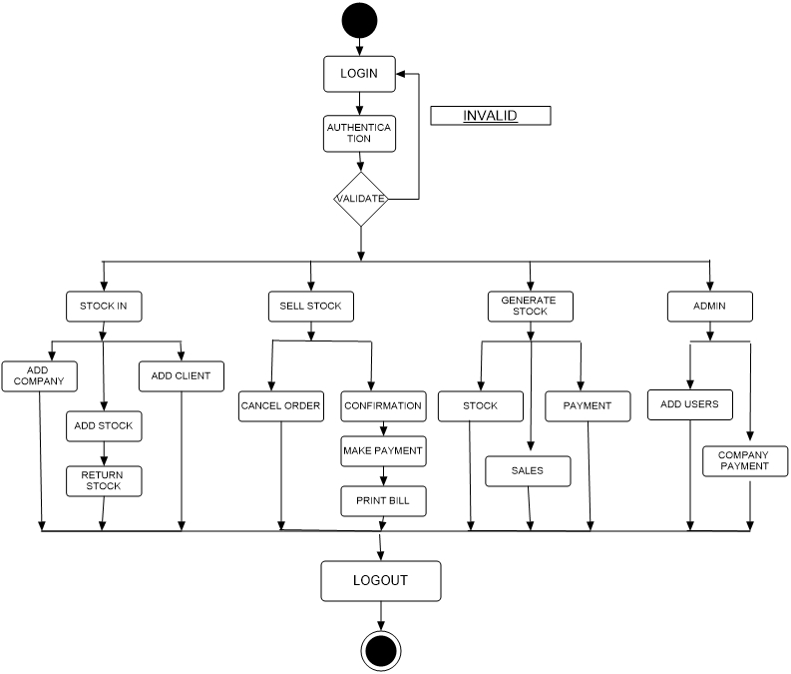
ACTIVITY DIAGRAM

Slide 19
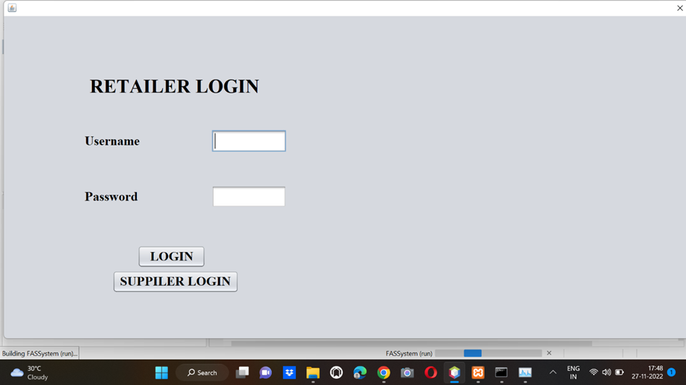
OUTPUTS

Slide 20
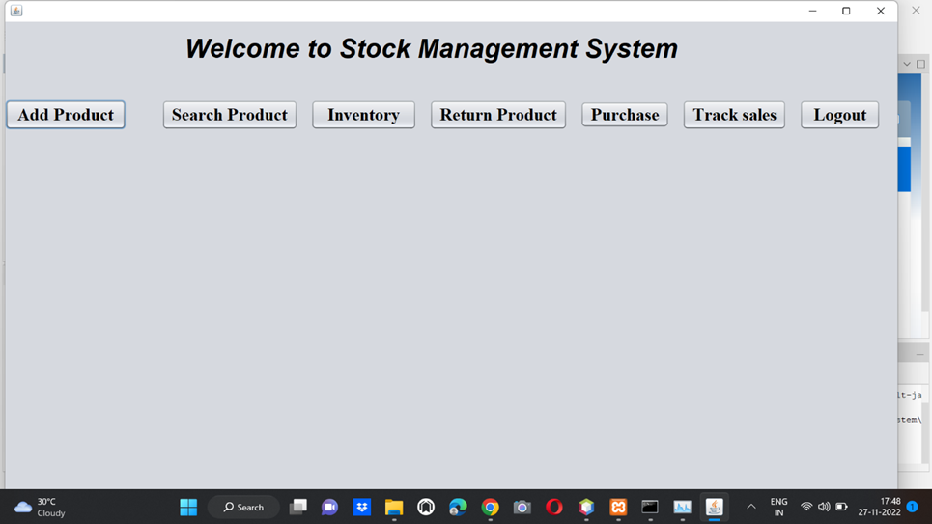
MAIN PAGE

Slide 21
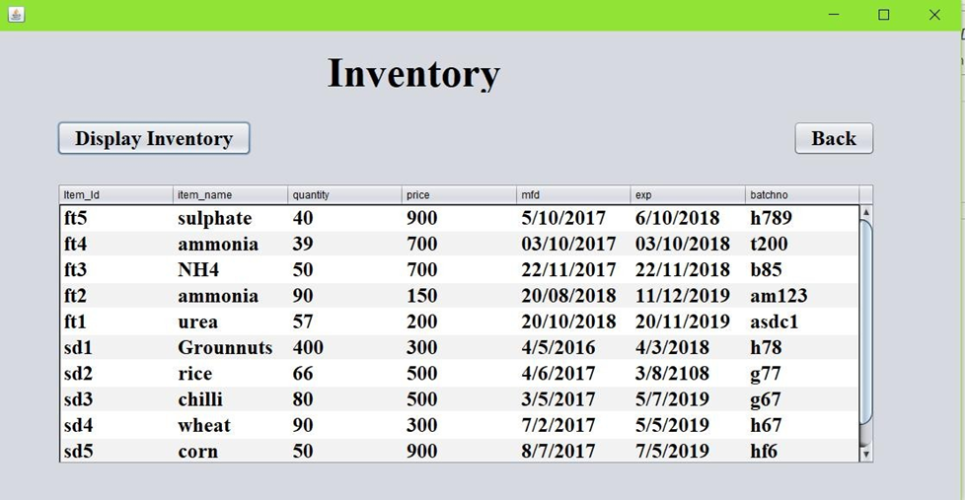
DATABASES

Slide 22
CONCLUSION
In this project we have developed a system which helps the retailers to sell and manage their products easily. It covers the functional areas of erp such as Marketing and sales, Supply chain management, Accounting and Finance and Human Resources. So this can help in increasing the sales of the retailer through the help of the inventory management. So the required products can be bought based on the demand. In future the products can be scanned with the help of barcode scanner. A system can be developed to take order from the customers online and deliver them. The customer relationship can be built with the help of feedback.

